Slide 1
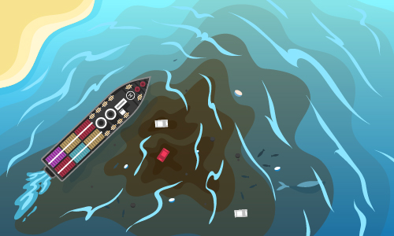
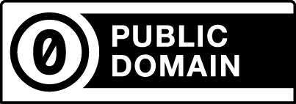
After Chemical Spill, Oil Spill Risk in Sri Lankan Waters
-- News Reference: Fair Use, Al Jazeera
-- Illustration 142194447 © Artur Balytskyi | Dreamstime.com
REGULATION: Such as a cap
Number of spills allowed – which is then traded as instruments
ECONOMICS: Tackling unemployment, so wages match qualification.
EDUCATION: Enabling rapid development of technologies to neutralize oil & chemical particulate
Mitigation Strategies
-- Mitigation Strategies, Copyright and related rights waived via CC0

